Slide 1
Intense Interactions
Gary Woodward

Slide 2
Communication
Many people with learning disabilities find some parts of communicating hard. Some people may have little or no language. They might find it hard to:
• Understand what other people say
• Tell other people what they want or how they feel
If you can’t tell other people what you want (or don’t want!) challenging behaviour can be more likely. Making communication better can reduce challenging behaviours

Slide 3
Communication
Common communication difficulties -Knowing how much someone understands
It can be difficult to know how much someone understands. We get lots of clues from what is happening around us and what normally happens. This is a good thing but sometimes it can make people think someone understands more words than they do.
Using short sentences and giving people one bit of information at a time can help.

Slide 4
Communication
Some words are easier to understand than others
Concrete concepts refer to things we can see and touch. These include people, places and objects (e.g. mum, shops, table). Abstract concepts refer to things that cannot be seen or touched. These include negatives (e.g. “not”, “don't”), and time concepts (e.g. “yesterday”, “this afternoon”). Abstract words are particularly difficult to understand. Sentences with abstract concepts in them can be easily misunderstood.
Teacher’s message - “Sam, you’re not going in the car”.
Message understood by Sam - “I’m going out in the car”.
Sam does not understand "not" so thinks that he is going by car and becomes distressed when he realises he will have to walk. The message would have been clearer to Sam if the teacher had told him what he was going to do e.g., "Sam, we are going to walk”.

Slide 5
Communication
Other problems with communication
Taking things literally
Hearing loss
Difficulty sending messages
Non-verbal, poor signing
Struggle with social rules /expressing feeling

Slide 6
Communication
Other ways to communicate
Objects of reference
Signing
Symbols of pictures
VOCA
Total communication approach

Slide 7
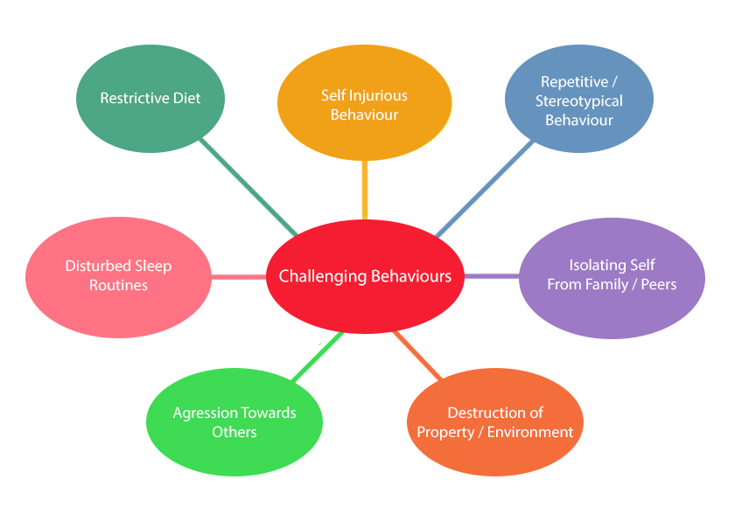
All Behaviour has Meaning

Slide 8
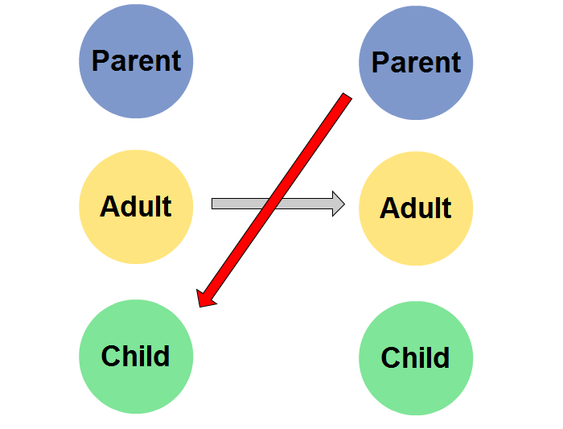
Transactional Analysis

Slide 9
Non verbal
Any communications with emotions or feelings is made up as follows:
7% WORDS
38% TONE
55% BODY LANGUAGE
CONGRUENCE

Slide 10
Supporting Communication
Gain their attention
Use short simple sentences
Give time
Use additional communication
Give lots of opportunity to respond
Repeat and paraphrase
Reflect and mirror
Be consistent and always be positive !

Slide 11
History of Intense Interactions
Intensive interaction was an approach originally conceived at Harperbury Hospital School during the 1980s by teachers Dave Hewett and Melanie Nind. The school was for young people with profound learning disabilities, sensory or physical disability and ‘challenging behaviour’. Their curriculum was traditionally based around rewards, rewards withdrawal, periods in ‘time out’ and exclusion (Nind & Hewett, 1994)

Slide 12
Introduction
Intensive Interaction can be used as a way of teaching or simply as a way of being with people. It enables us to focus on the quality of our everyday interactions. When we adopt Intensive Interaction as an approach we go about things in a particular way - we adopt a particular interactive style.

Slide 13
We should :
Adjust our interpersonal behaviour (less threatening more interesting)
Take the persons lead , joining in respond not lead
Treat the things they do as communication
Use sensitive observation assess how interactions are going , respond and keep interactions positive and fun
Use timing, rhythm and repetition the interactions ,help the person to predict what happens next and be more involved
Have fun

Slide 14
Who would benefit
Intensive Interaction can be useful for children and adults with:
Severe and complex learning difficulties.
Very severe learning difficulties.
Profound and multiple learning difficulties.
Multi-sensory impairments.
A diagnosis of autism spectrum disorder.
A range of self-stimulatory or socially isolating behaviours.
A learning disability.
Behaviour that challenges.
Late-stage dementia.

Slide 15
Can help them to :
Using and understanding eye contact and facial expressions.
Taking turns in sequences of social behaviour.
Developing use of vocalisations.

Slide 16
When and where
Using the Intensive Interaction approach means using the interactive style described above. We can do this at any time and in any place. It is most effective, though, when we do two things together. First, when we seize opportunities as they arise - during care tasks, quiet moments, when the person with learning disabilities is in the mood for being social. Second, when we plan to set aside some time each day when there is nothing else to be done or to distract us from giving our full attention to having a quality interaction. And then giving quality time to reflecting on the interaction.

Slide 17
Jennifer and Lana

Slide 18
How to use Intensive Interaction
The first step is to get comfortable in your environment; make sure that you’re at eye level with them, or close enough so that they can see you.
Introduce yourself. You may use your own touch cue or symbol to represent this.
Wait and see what the person does. Start by mirroring any gestures, facial expressions or vocalisation.
Continue this for the next few minutes, seeing if you can notice any differences or changes in the way that they are communicating with you.
Let them take the lead. If they walk away or show you that they want to stop, let this happen. They might begin to look away if they are disengaged, or they might sign to you that they are finished. Others might benefit from looking with their eyes at ‘yes’ or ‘no’ symbols, after you have asked if they would like to stop, which you can create here.
You can introduce other objects in Intensive Interaction; using mirrors can be a great way for therm to see their own facial expressions.

Slide 19
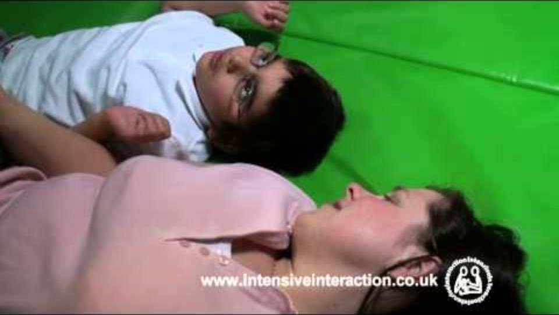
Sasha and Riana

Slide 20
Multi Sensory Impairment
MSI children still need people to communicate with them, it just needs to be an appropriate form of communication, and within their symbolic level of understanding. You can still take part in Intensive Interaction activities, all you’ll need to do is adapt the sessions to suit their needs. To do this, you can:
Choose to use ‘running commentaries’ during each session. You can say things like, ‘I can see you looking at me’ or, ‘here’s the object, from me to you.’ This can help MSI children to feel socially engaged with you.
Amplify your speech and make sure your voice is clear. Remember: don’t always assume that children can hear you; some children may not be able to.
Use their preferred communication methods, which could be body movements, speech, sign or braille. Make sure that you respond to their efforts in communicating with you.
You can use objects or touch as a way of having a shared focus. To help a child know what they’re interacting with, objects of references can be helpful to use before presenting the child with the item.
Intensive interaction is heavily focussed on eye contact and vocalisation, so it needs to be used with care for MSI children. Ensure that you get to know the child you’re working with so that you can tailor the sessions to meet their needs.

Slide 21
In Summary
HAVE PATIENCE
FOLLOW THEIR LEAD
HAVE A KEEN EYE FOR DETAIL
HAVE PLANNED AND SPONTANEOUS SESSIONS
THINK ABOUT THE ENVIRONMENT

Slide 22
thank you
Gary Woodward
www.gcareconsultants.uk

